Slide 1
Humane SPICE Import
David Y. Kay

Slide 2
Let’s view JUNO in OpenSpace!

Slide 3
JUNO Mission .asset file

Slide 4
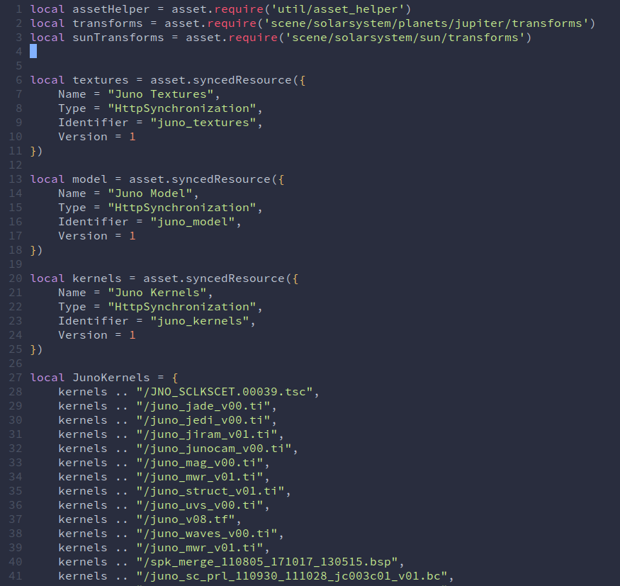
Library Imports
Provided by other developers
Explicit Reference to 101 data files

Slide 5
Library Imports
Provided by other developers
Guided Reference to 101 data files

Slide 6
Let’s get our data!

Slide 7
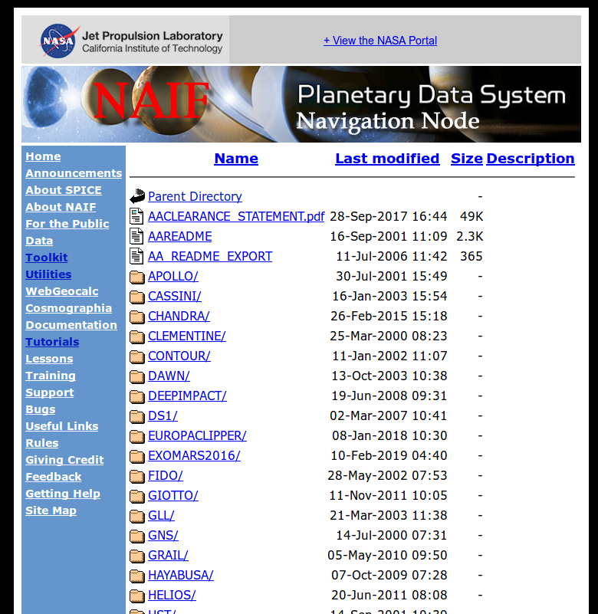
Welcome to NAIF

Slide 8
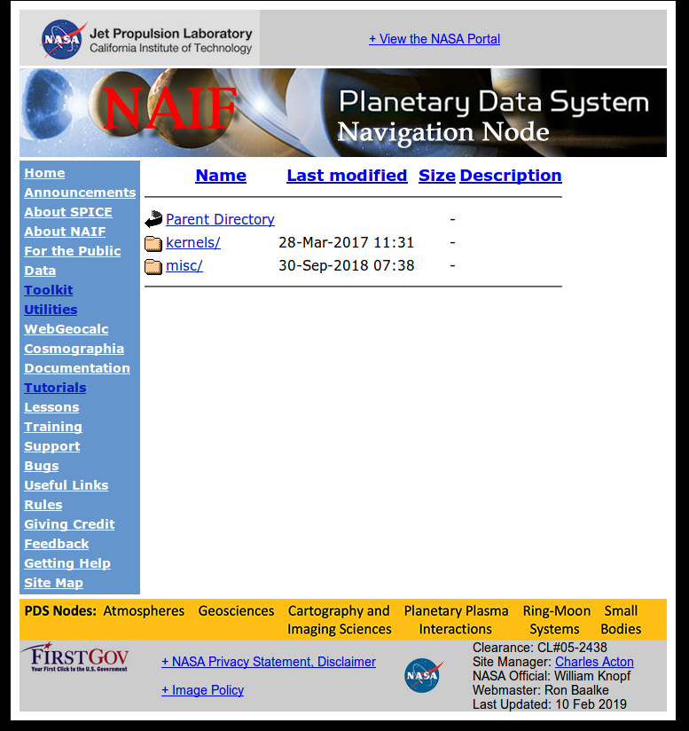
JUNO/

Slide 9
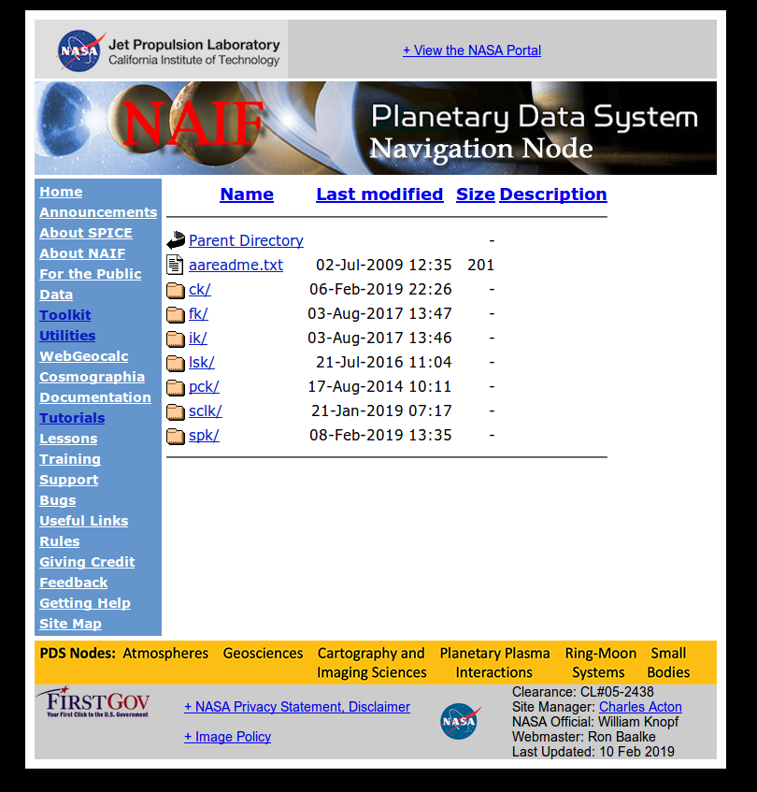
JUNO/
kernels/

Slide 10


Slide 11
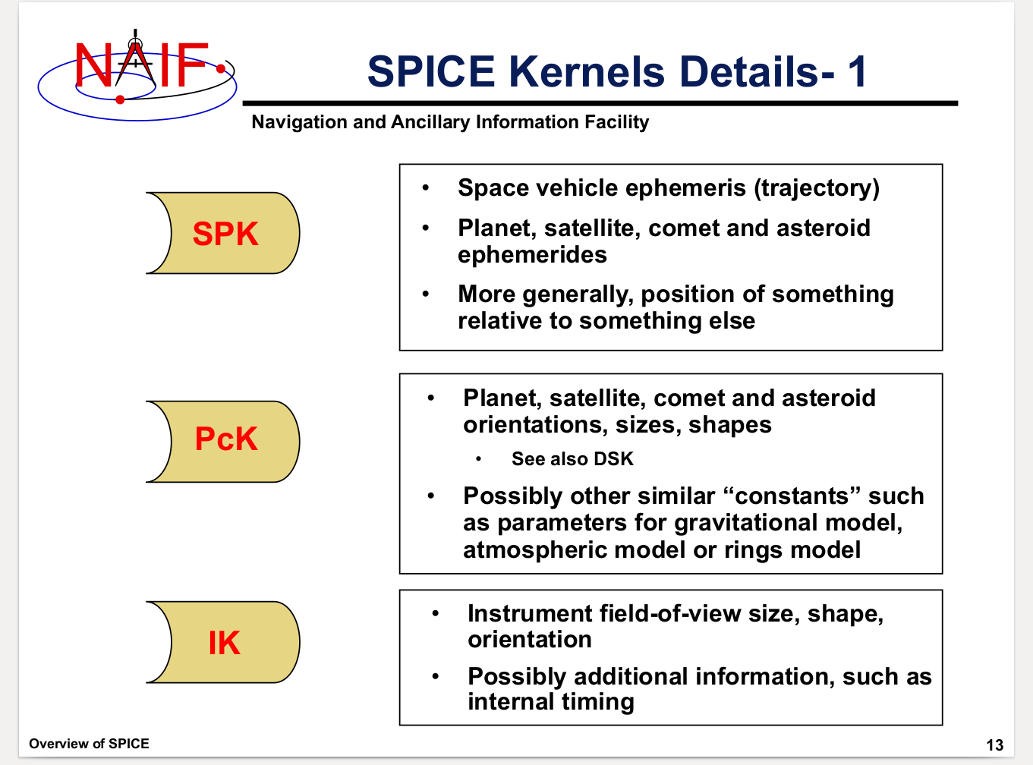

Slide 13
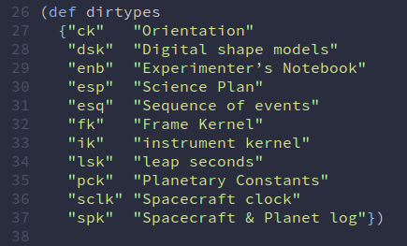

Slide 14
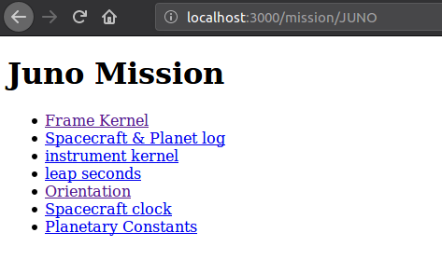

Slide 15
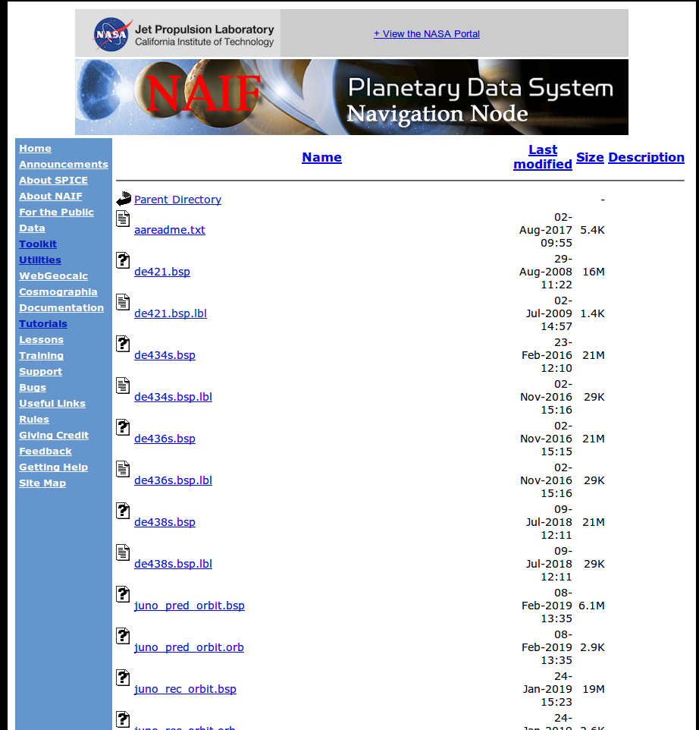
JUNO/
kernels/
spk/

Slide 16
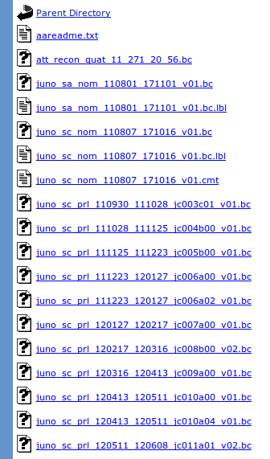
JUNO/
kernels/
ck/

Slide 17
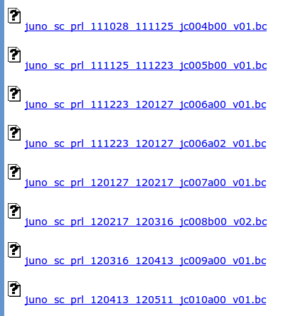
Mission
Craft Orientation
Long-term Prediction
Start date? Y/M/D?
End date? Y/M/D?
Where is V1?
UUID/tag?
Binary ck file

Slide 18
Let’s simplify?

Slide 19
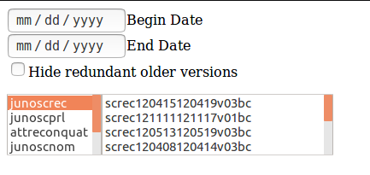

Slide 20
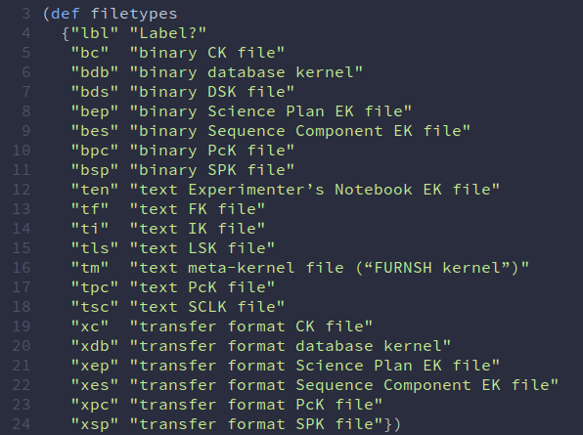

Slide 21
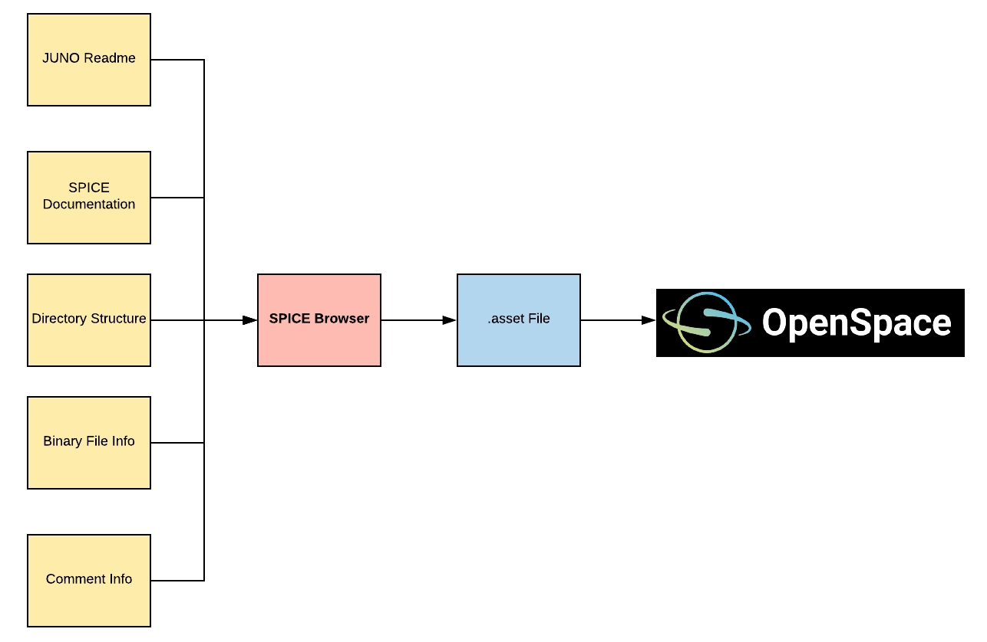

Slide 22
Frame Data!

Slide 23
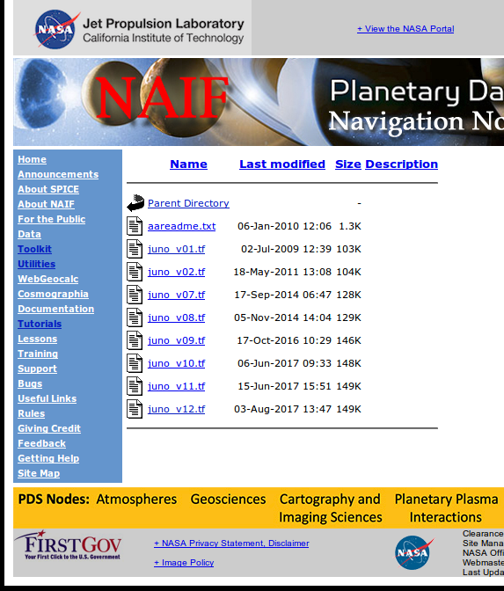
JUNO/
kernels/
fk/

Slide 24
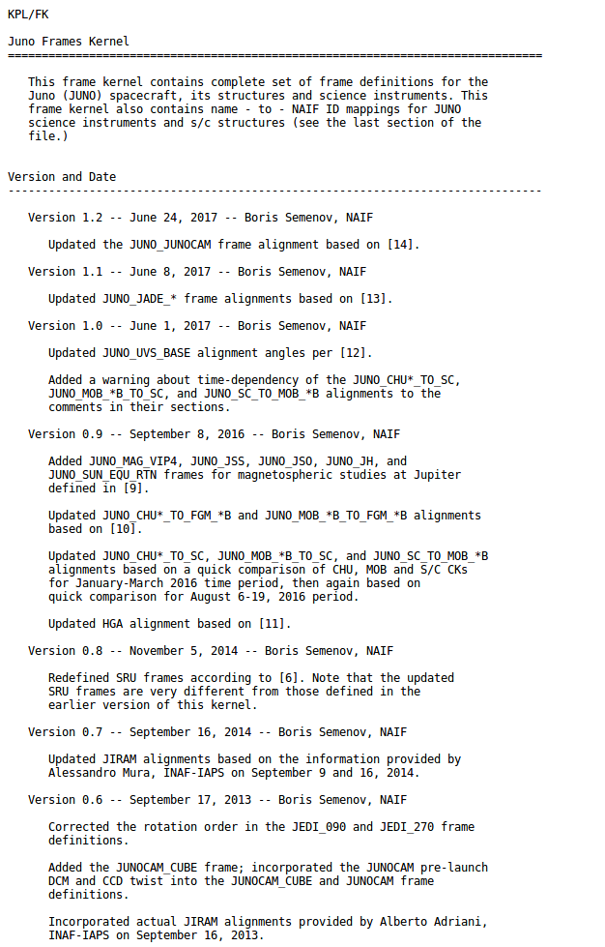
Frame
Changelist

Slide 25
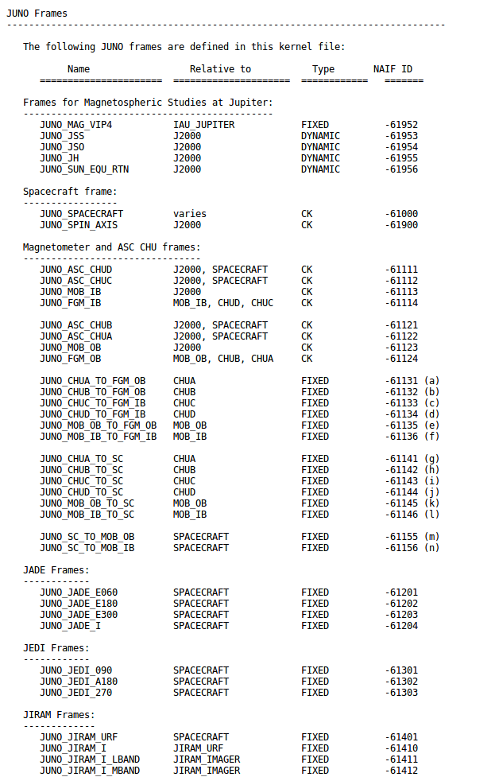
Frame
List

